Slide 1
Emerging Roles within Care Coordination
KEY CONSIDERATIONS

Slide 2
Overview and Objectives
Overview: This session will focus on the emerging roles and workforce needs facing Care Coordination in today’s marketplace. As Care Coordination becomes increasingly critical to managing populations both within and outside of the traditional healthcare settings, the need for a different and diverse workforce raises some key areas of consideration for the profession. Key considerations to meet this challenge will be presented.

Slide 3
Objectives
Describe forces driving market demand and impact on emerging roles in many areas for Care Coordination
Understand the affect of aging of the workforce and increasing market demand on pipeline and care coordination recruitment and development
Describe key areas of consideration related to scope of practice and entry into care coordination roles competency and credentialing
Articulate requirements for oversight and supervision, interdisciplinary communication and escalation driven by workforce expansion

Slide 4
Driving Forces and Market Demand
Focus on Value
Shift in Settings in which care is provided
Expanding Opportunities in Care Coordination as it there is heightened recognition of the value of this specialty to managing populations

Slide 5
What is Value in Healthcare?
  Value= Quality divided by cost (Porter, 2010)
  Ownership of value equation is mandate that engages nurses in examination of clinical practice and performance outcomes as well as cost and potential for revision of payment structures to improve affordability (Porter- O’Grady and Malloch, 2006)
  The health outcomes achieved that matter to patients relative to the cost of achieving those outcomes (Lee and Porter, 2013)
Notes:
Need lee porter citation

Slide 6
What is Value from Other Perspectives?
Provider Perspective
  Ability to deliver quality care to their patients in an efficient and effective manner with minimal burden
  Ability to be paid reasonable rates for care provided
Nursing Perspective
  Care that is holistic, coordinated, science based, safe and cost effective (AONL, 2020)
Payer Perspective
High quality care and preventive services for the lowest cost!

Slide 7
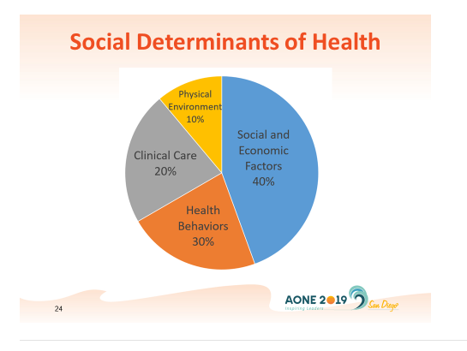
Factors Impacting Health Outcomes

Slide 8
The Burden to Society is Significant
Healthy lives
Access to care
Health care quality
Efficiency
Equity
Chronicity of Patient Populations
Social Needs Add Complexity
Social determinants Drive Outcomes
Notes:
Healthy lives: The U.S. does poorly, ranking last on infant mortality and on deaths that were potentially preventable with timely access to effective health care and second-to-last on healthy life expectancy at age 60. (Schneider, etal, 2017)
Access to care: People in the U.S. have the hardest time affording the health care they need. The U.S. ranks last on every measure of cost-related access. More than one-third (37%) of U.S. adults reported forgoing a recommended test, treatment, or follow-up care because of cost. (Schneider, etal, 2017; Conwell and Cohen, 2002)
Health care quality: The U.S ranks in the middle. On two of four measures of quality—effective care and patient-centered care—the U.S. ranks near the top (3rd and 4th of 11 countries, respectively), but it does not perform as well providing safe or coordinated care. (Schneider, etal, 2017)
Efficiency: The U.S ranks last, due to low marks on the time and dollars spent dealing with insurance administration, lack of communication among health care providers, and duplicative medical testing. Forty percent of U.S. adults who had visited an emergency room reported they could have been treated by a regular doctor, had one been available. This is more than double the rate of patients in the U.K. (16%). (Schneider, etal, 2017)
Equity: The U.S. ranks last. About four of 10 (39%) adults with below-average incomes in the U.S. reported a medical problem but did not visit a doctor in the past year because of costs, compared with less than one of 10 in the U.K., Sweden, Canada, and Norway. (Schneider, etal, 2017)
Chronicity of Patient Populations: High proportion of health care services treat chronic conditions that are expensive to manage resulting in increased spending (Olin & Rhoades, 2005).
Social Needs Add Complexity: Factors such as mental health and substance abuse, extreme medical frailty, and a host of social needs such as social isolation and homelessness add to the complexity (Berwick, Nolan & Whittington, 2008).
Social determinants Drive Outcomes: such as food, housing, and safe environments often are lacking, but payment structures in the health care system do not allow such alignment (Freeman, 2006).
Half of U.S. health care dollars are spent on five percent of the population (Conwell & Cohen, 2002).

Slide 9
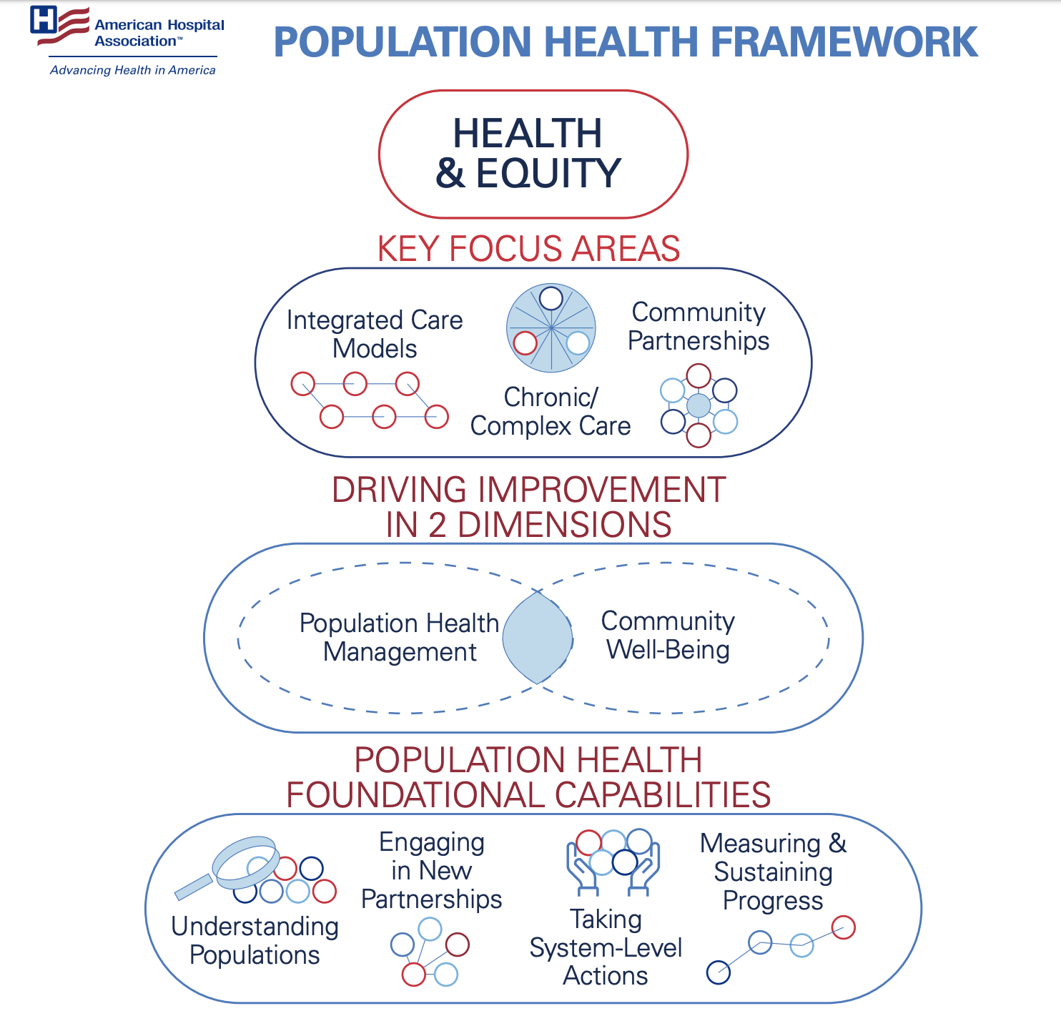
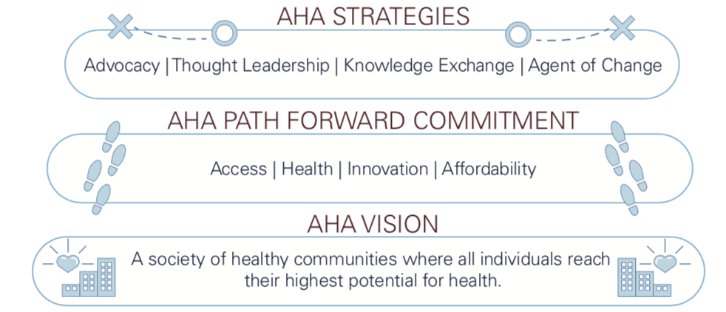
What is Population Health, According to the AHA?

Slide 10
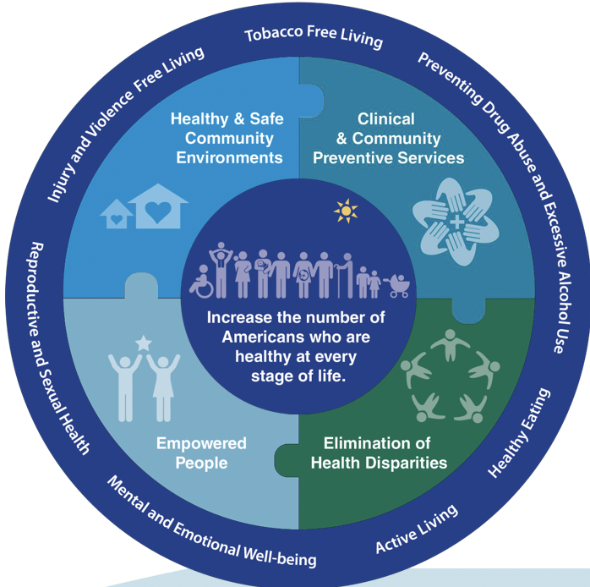
National Prevention Strategy
National Prevention Council, National Prevention Strategy, Washington, DC: U.S. Department of Health and Human Services, Office of the Surgeon General, 2011.

Slide 11
National Trends
Risk Shifting to Providers
Federal Requirements - Medicare
Medicaid Reform
Insurance Industry Consolidation
Direct Contracting
Third Party Disrupters

Slide 12
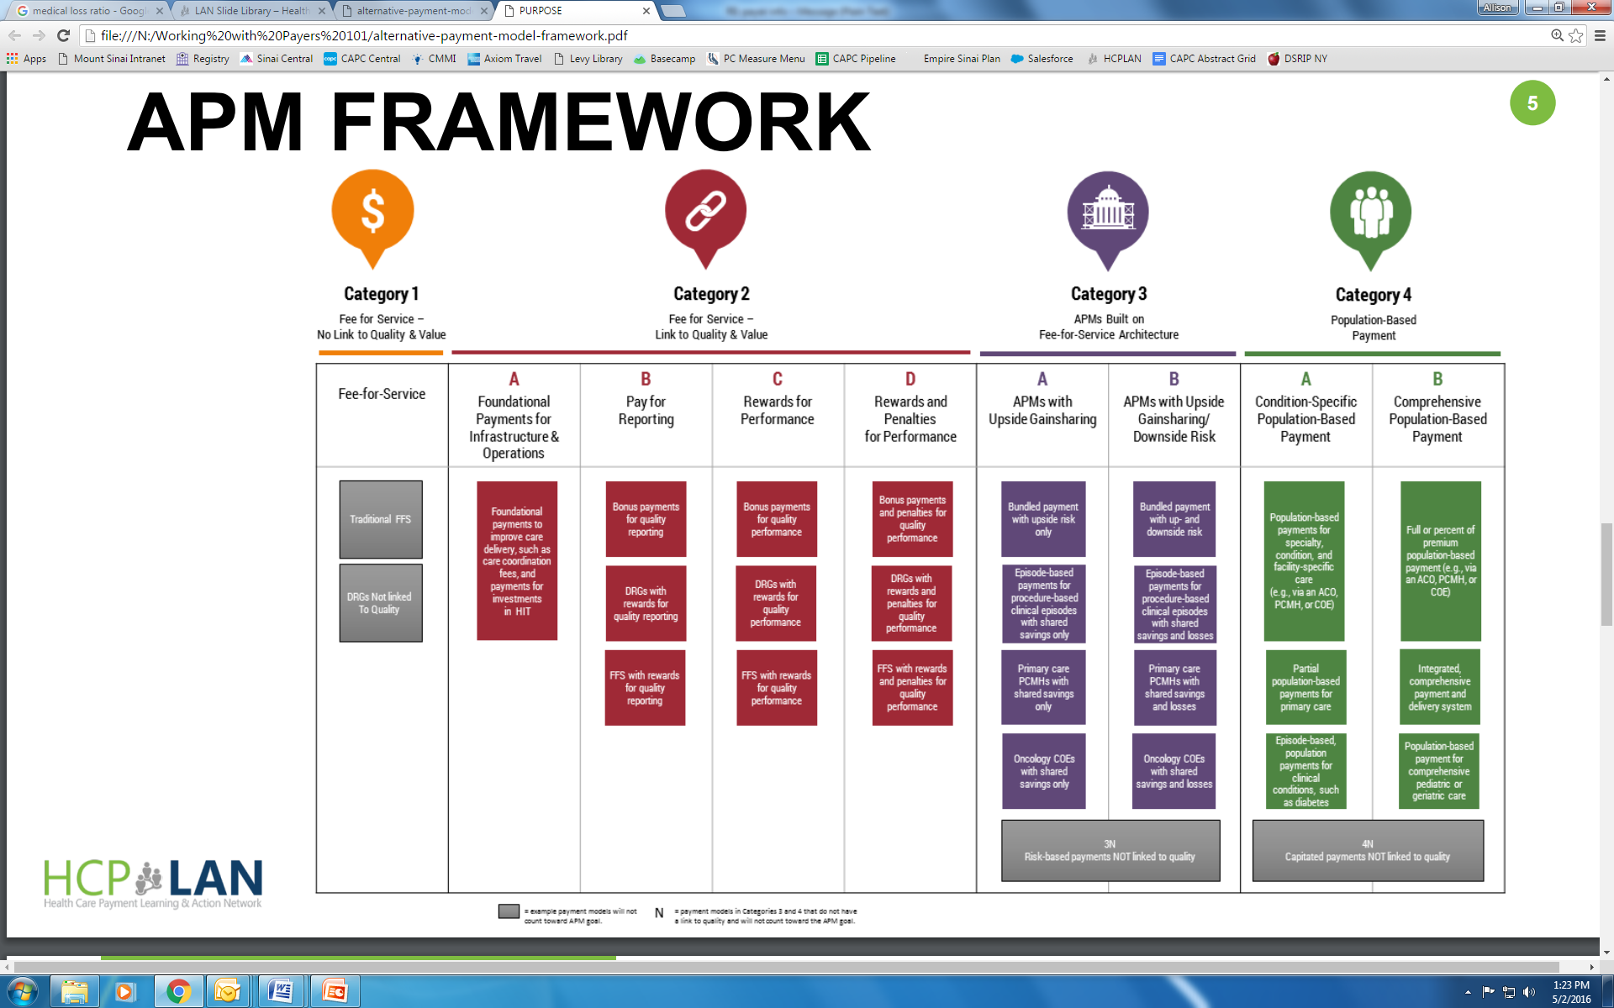
4 Categories of New Payment Structures
Source: Alternative Payment Model (APM) Framework and Progress Tracking (APM FPT) Work Group.
Notes:
Need fuller citation

Slide 13
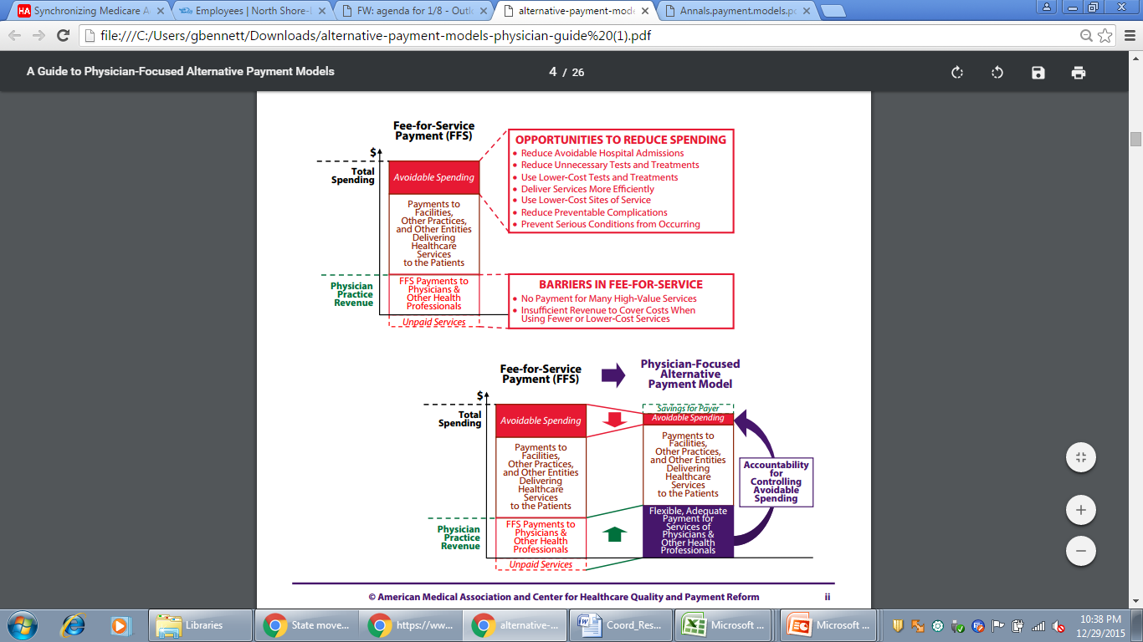
Sustainable Opportunity Improve Patient Care
Notes:
Gerry we moved talking points down because we felt this graphic is so important needed to be bigger
Services such as patient care coordination, not typically reimbursed in fee-for-service models, become aligned financially with value-based programs. This provides the business case to invest in care managers, social work and resource specialists

Slide 14






Third-Party Disrupters

Slide 15
Shift in Care Delivery Underway
Total National Health Expenditures 1980-2016 (AHA,2018)
  Percentage of Gross Domestic Product: 13.9% from 1995 to 17.9% in 2016
  <1Trillion in 1980 to 5.5 Trillion by 2025
Shifting Volumes 1995-2016 (AHA,2018)
  Outpatient Revenue 30% to 48% and Inpatient from 70% to 52%
  Inpatient Volumes decreased from 11.93-10.63%
  Length of Stay reduced from 7 days to 5.4
  Ambulatory Volumes increased from 14.22% to 21.45%
Shortages of WorkForce and Other Complexities
  Shortage of Primary and Specialty Care Providers (Haas and Swan, 2014; Macy, 2016)
  Physician Burnout and Caregiver Burnout (Rotenstein et al, 2018; Cipriano, et al, 2013)
  Electronic Medical Record, Complexity of Patients, Regulatory Standards

Slide 16
Findings and Recommendations
A diverse and broad set of skills and competencies are needed by the care coordination and care management workforce.
Ongoing training and supervision are needed for staff who will provide care coordination and care management.
Recruitment and retention challenges are prevalent, driven by insufficient salaries, high caseload and lack of appropriate skills and competencies.
Job titles for those providing care coordination and care management are still evolving.
Source: Who’s Going to Care? Analysis and Recommendations for Building New York’s Care Coordination and Care Management Workforce (2015)

Slide 17
Emerging Roles - Key Areas of Consideration
  The need for a different and diverse workforce raises some key areas of consideration for the profession
  Aging Workforce/Pipeline
  Competency and Credentialing
  Oversight and Supervision
  Interdisciplinary Team Structure

Slide 18
Aging Workforce and Pipeline
  Aging of the workforce
  Branding issue - Care Coordination as a “specialty”
  Challenges in RN Curriculum and Preparation – absence of Care Coordination rotations in RN programs
  Internship and Fellowship Programs and funding
  Interdisciplinary Team Focus – crucial skill set

Slide 19
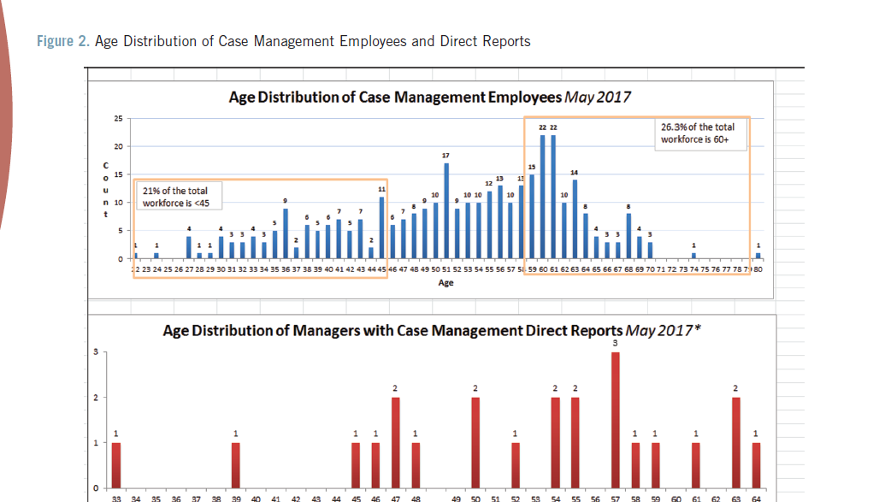
Aging Workforce

Slide 20
Competency and Credentialing
Lack of Standard Nomenclature and Titles
Scope of Practice
Lack of standard competencies for entry into practice
Cultural Diversity and Competency – workforce matching the community served
Matching Appropriate Skills with Population needs

Slide 21
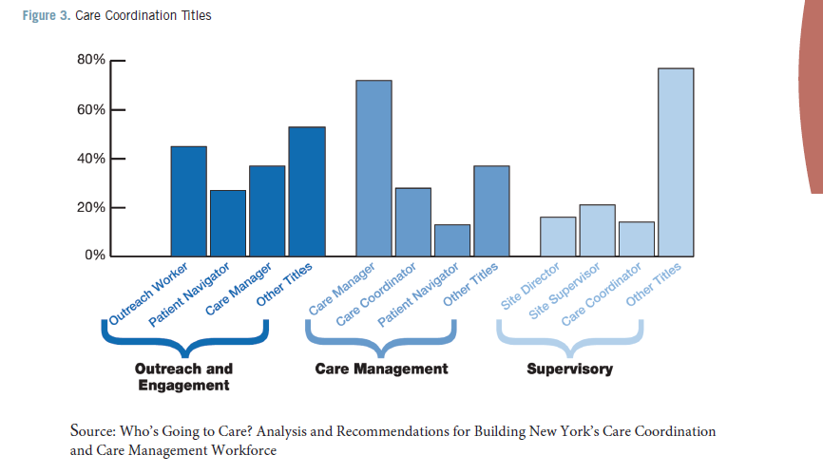
Titles and Competency

Slide 22
Care Coordination Components and Practices
Targeting: enroll individuals with high likelihood of hospitalizations to benefit from intervention
Staffing: Longitudinal care delivery provided by multidisciplinary teams (RN case managers deliver intervention with support from other disciplines)
Primary care provider collaboration: Care manager in regular contact with PCPs
Information technology: system for documenting care and providing timely information on admissions and Ed visits
Training and feedback: All staff receive training on care coordination with regular, specific feedback on outcomes for their panel of patients
Notes:
Spell out mccd

Slide 23
Commonalities Across Models
Identify high risk for hospitalization patients in coming year and improve knowledge, adherence to treatment and self-care
Improve communication and coordination between patient’s PCP and specialist
Work with providers to provide care using evidence based guidelines
Monitor patient’s symptoms, well-being and adherence between clinical visits
Advise patient when to see provider
Notify PCP of health status change
Leverage Tele/Virtual Health to achieve connection, transition and coordination
Notes:
I pulled this from billies slides- themes from all that she shared… it might be helpful if we are not talking specific models- we could say, “commonalities across interventions or strategies”

Slide 24
Oversight and Supervision
  Ensuring that scope of responsibility is equivalent to level of training
    Clear delineation of roles and responsibilities
    Minimum standards - entry into role and competencies
    Training and Orientation
  Designing appropriate communication and escalation protocols
    Alerts and Notifications
    Protocols for escalation and clear chain of command based on scope of practice
  Managing remote work teams
    Audit tools
    Interoperable care plans that are transferable to multiple platforms

Slide 25
Effective Care Coordination Interventions
  Follow evidence-based guidelines
  Complete multi-dimensional in-home assessment
  Collaboratively develop and implement a plan of care with action plans and goals with patient, family and PCP
  Implement self-care coaching and support that includes a medication management plan, using evidence based protocols and models
  Facilitate communication among patient’s providers concerning their health status
  Monitor and evaluate patient’s symptoms, well-being and adherence to plan of care between PCP appointments
  Manage care setting transitions especially from hospitals and skilled nursing facilities
  Arrange and coordinate support services

Slide 26
Interdisciplinary Team Structure
Complex process in which different types of staff work together to share expertise, knowledge, skills to impact patient care
Paucity of evidence of effective ways of delivering interdisciplinary team work
Multifactorial related to nature of the teamwork, skill mix, setting of care, service organization, individual relationships and management structures
Interventions to improve disciplinary work focus on specifics of teamwork (sharing pf patient files, case conferencing approach, meeting style or frequency

Slide 27
Characteristics of an effective interdisciplinary team
Leadership and management
Communication
Personal rewards, training and development
Appropriate resources and development
Appropriate skill mix
Climate (trust, respect and valuing other team members)
Individual characteristics (knowledge, experience listening, self-awareness, reflexive practice)
Clarity of vision (clear values that drive service, uniform and consistent)
Quality outcomes of care
Respecting and understanding roles

Slide 28
Documentation
Integrated medical records not always the answer (providers finding pertinent info in timely manner)
Shared care plans visible across care continuum with essential data summary (? cloud based with broad access)
Requires longitudinal care delivery model implementation
Data Collection systems to demonstrate success
Identification of high risk patients in all settings

Slide 29
Work Flows – Key to success
Disciplines/Agencies/Professions charting out their territory
Build on what already exists
Compromise and build relationships
Be patient and persevere
Focus on what is best for the (patient) person
Work with who is willing to play
Map out workflows and make compromises

Slide 30
Regulatory Standards
CMS.Gov
End-stage Renal disease (ESRD)
Hospital Value-Based Purchasing
Hospital Readmission Reduction Plan (HRRP)
Value modifier (VM) Program
Hospital Acquired Conditions (HAC) Reduction Program
Skilled Nursing Facility Value-Based Program(SNFVBP)
Home Health Value Based Program (HHVBP)

Slide 31
Emerging Roles and Opportunities

Slide 32
Care Coordination Leadership
Aging Workforce
Increased demand
Pipeline
Training and Education
Minimum competency
Leadership and Care Coordination Skill Set

Slide 33
Policies and Procedures – Development
Interdisciplinary teams map out need for policies and co-create
May need approval at many levels by multiple agencies/facilities/committees
Consent forms for sharing of information= most complex
Compliance, attorneys, safety officers, HIPAA
Demonstrate : “Need to know” while maintaining confidentiality to coordinate care and maximize success
Difficult to hard wire new patterns of referral, knowledge of community agencies for referrals and value

Slide 34
Education and Training
Lack of formal curriculum
Branding issues
Lack of qualified subject matter experts
Lack of Mentorship/Fellowship Opportunities

Slide 35
Data and Analytics
Need for qualified personnel that possess both clinical and analytical abilities - Digesting Big Data and determining actionable and impactable populations
Understanding metrics and risk - upside and downside
Financial modeling – cost of deployment of Care Coordination Program vs Potential ROI
Metrics and Real Time Performance Measurement - Structure Process and Outcomes Measures

Slide 36
Clinical Informatics
Integration of multiple systems for communication
Need for real time alerts and escalation
Data and programmatic monitoring
Interoperability across the continuum – Care Plans
Artificial Intelligence
Data extraction and performance metrics across multiple systems – design with the end in mind
Ability to interpret clinical needs and build supporting infrastructure

Slide 37

TECHNOLOGICAL
INITIATIVES
Health Information Exchange (HIE) Integration
Jvion Artificial Intelligence Solution
Conversa Health Automated Chatbot
Valera Health & Behavioral Health
Clinovations Risk Identification & Capture Solution (RIC)
Emergency Communication Nurse System (LowCode®)
Post-Acute Analytics

Slide 38










TRANSITIONAL CARE MANAGEMENT
Care Navigation Model
Care Across the Care Continuum
  In-Person Visit during hospital stay
  Access to 24/7 Call Center
  Enroll in Conversa
Inpatient
  Real-Time Notification for ED Presentations
  Clerical Note entered into ED chart
  Hospital team takes action to meet patient in the ED
ED Action Team
  High Risk patients receive a home or SNF visit
  Post Acute Analytics used for SNF LOS management
Community Visits
24hr D/C
  Every Patient called within 24hrs of discharge
    Discharge Instructions
    Medication Reconciliation
    Verify provider f/u appointments
    Facility/Home Discharges
    Homecare Visit
Community Connections
  Community Based Care Mgmt
  Behavioral Health Care Mgmt
  Health Home
  Healthy Living
  Tobacco Cessation
Confidential: Education Law 6527: Public Health Law 2805, J., K., L., M.

Slide 39
Quality Improvement and Safety Nursing Expertise
ACO population healthcare delivery models and funding = emphasis on achievement of identified domains and measures
Benchmarking methodology, sampling and scoring (CMS 2015)
Nurses developing care processes, evidence based pathways resulting in reduction of cost with improvement of quality
Shared care plans driven by identification of goals identified by individual partnered with lead care coordinator

Slide 40
Telehealth
Emerging area of opportunity
Highly Technical – multitasking using several technologies to facilitate communication
Opportunity for experienced RN’s with strong clinical skills that are unable to perform bedside
Virtual Care Delivery
Remote workforce requires oversight and escalation protocols
Clinical guidelines for assessment and escalation

Slide 41
Marketing and “Sales”
Unable to impact and coordinate care if we can’t “sell the product”
  Patients and Caregivers
  Payers
Strong Patient Engagement skills essential
Branding and marketing materials describing program and benefits of enrollment
Analysis of marketing data to determine patterns that may engage members in programs by understanding areas of interest and buying patterns

Slide 42
Research and Publications
Need for Research and Publication regarding evidence based models of care delivery and outcomes
Study design and analytics
IRB and Approval Mechanisms
Writing and Publication

Slide 43
Community Health Worker Role
Community Health Workers are trained lay people who share socioeconomic backgrounds with their patients, which facilitates the workers’ ability to provide support consistent with the patients’ values and needs.
Integration into the health care workforce has been hampered by 3 Factors:
CHW Interventions (hiring, supervision and work practices) poorly standardized and difficult to reproduce
Most CHW Interventions are disease-specific limiting generalizability to growing patient populations with multiple chronic diseases
Published studies around the value of CHW Interventions are low quality
Source : Patient-Centered Community HealthWorker Intervention to Improve Posthospital Outcomes JAMA Intern Med. 2014;174(4):535-543. doi:10.1001/jamainternmed.2013.14327

Slide 44
IMPaCT Model – Individualized Management for Patient-Centered Targets
Goal: to create a standardized exportable CHW Model
Model consisted of 3 elements:
Recruitment and Hiring Guidelines
  Minimum educational requirements
  Personality Traits that patients identified as important (i.e. Active Listening)
Training
  Month long college accredited training course (Core Competencies for Community Health Work, Motivational Interviewing, Professional boundaries)
Standardized Work Protocols
  Goal Setting
  Goal Support
  Connection to Primary Care

Slide 45
IMPaCT Model Outcomes
Findings:
Intervention patient more likely to obtain timely post hospital follow up care
Reported higher quality discharge communication
Showed greater improvements in mental health
Showed greater improvements in patient activation
Less recurrent readmissions
However:
No significant differences in Physical Health
No greater satisfaction with Medical Care
No improvements in Medication Adherence
Interdisciplinary team comprised of an appropriate mix of skills and expertize is essential!

Slide 46
Next Steps
Collect data about the care coordination and care management workforce.
Require all payers to support care coordination and care management.
Ensure sufficient wages and benefits for care coordination and care management staff.
    Set a wage floor for care and care management workers;
    Ensure sufficient payment to meet compensation standards; and
    Ensure health plans are incentivized to invest in the community-based sector and community-based providers are incentivized to invest in their frontline staff.
Provide ongoing support for the development of the care coordination and care management workforce.
    Develop industry standards and certification programs;
    Fund education and training initiatives that leverage economies of scale;
    Establish care coordination and care management career ladders; and
Provide clinical supervision and support for unlicensed care coordination and care management staff.

Slide 47
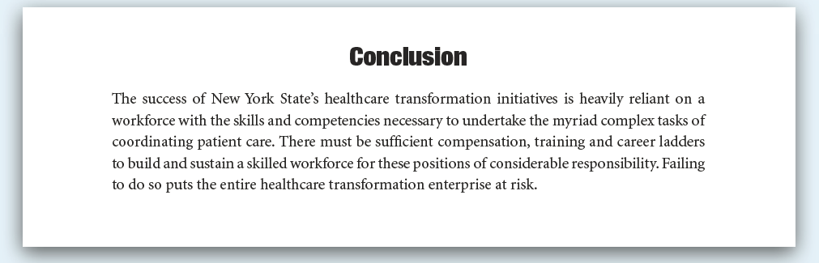
Source: Who’s Going to Care? Analysis and Recommendations for Building New York’s Care Coordination and Care Management Workforce (2015)

